Slide 1

BESTBUY Case Study
Team member: Bingbing Pan, Harsh Tandon, Tianqing Feng

Slide 2
Introduction- Business question
What are the customer attributes correlated with a high propensity to purchase the geek squad protection plan?
What is geek squad protection plan?
Geek Squad Protection Plans are an optional form of product coverage that provide additional value to BestBuy customers. It also provides additional coverage when manufacturer warranties come up short.
Notes:
In this case, we are trying to help Vice President of Marketing of Bestbuy to develop a targeted advertisement strategy on consumers who have a high propensity to buy the Geek Squad protection plan. However, the company does not have any information about those consumers. We need to do figure out the targeted consumers based on the limited dataset we have.

Slide 3
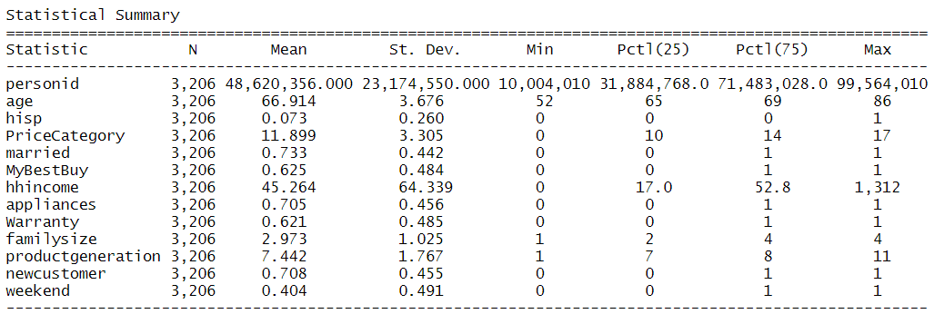
Introduction- Dataset
The dataset, named “BestBuy.csv” includes 3,206 transactions made in March 2017 and only from Santa Clara Best Buy stores.
Notes:
“PriceCategory” divided price of product in 18 groups. 0 means price is lower than 10 while 17 means the price is higher than 10000.
“MyBestBuy” is the name of the credit card of Best buy, it shows whether the consumer has the credit card.
“Hhincome” means household income, and the unit of it is $1000. Because the differences between maximum and minimum values is really big, we logged those values in our models.
“Appliance” is a dummy variable for product is home appliance or not.
“Warranty” (Geek Squad protection) represent people will buy the Geek squad plan or not, which is also the Y variable in our models.
“Productgeneration” represents the version of the product, the higher number means the product is newer.
“Weekend” shows people purchase product on weekends or weekdays. 40% are purchased on weekends.

Slide 4
How do we solve it?
Summary of dataset (correlation)
Methods we used: Binary Logit and Random Forest
Model Comparison
Result of Binary logit
Model Visualization
Recommendation

Slide 5
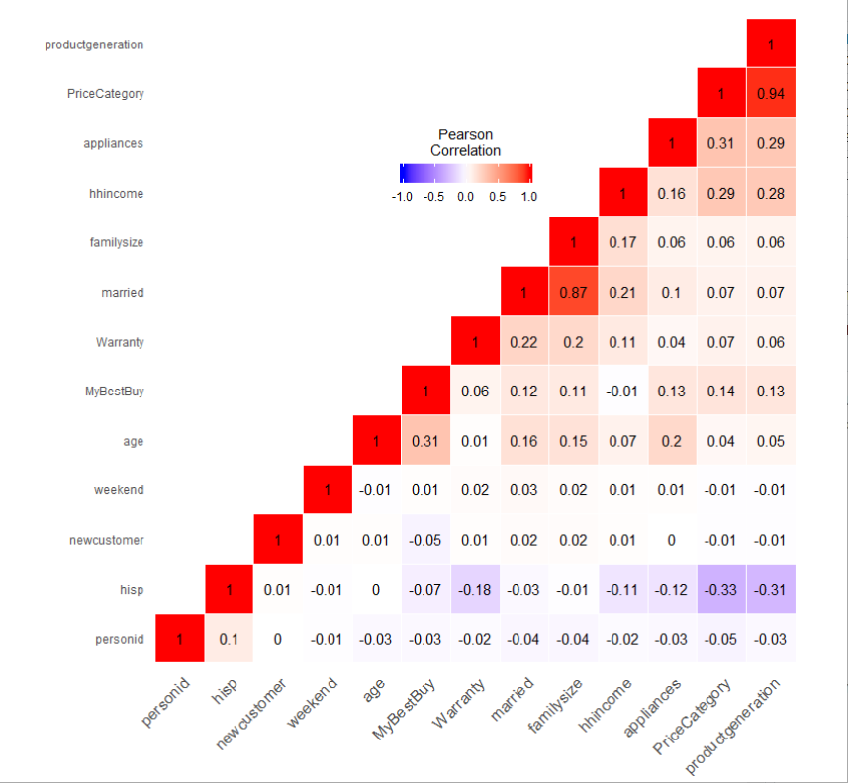
Variable Choices
Price Category & Product generation
Highly Correlated
Married & family size
Notes:
In this graph, we can see that price category and product generation are highly correlated. And also married and family size are. Bases on it, we will not use product generation and married variables in our model.

Slide 6
Binary Logit and Random Forest
Binary Logit
When you target variable is binary.
Provide insights into importance of each variable
When you want a quick initial benchmark.
Random Forest
An ensemble method that uses several independent decision trees to work together.
Performance is usually better.

Slide 7
Model Comparison
Binary Logit vs. Random Forest
Accuracy: 67.71%
AUC Score: 63.75%
Accuracy: 66.61%
AUC Score: 61.18%
Notes:
The Binary Logit model gives a quick benchmark and allows you to see which variables are affecting our Y the most. We try different combination of X variables and compare the training results of each. We see that model 5 performs the best as its AIC score is the lowest.
A random forest merges a collection of independent decision trees to get a more accurate and stable prediction. It is an ensemble method that combines several decision trees to lower both bias and variance.
Here, we train our random forest model with our training data and 500 independent decision trees.

Slide 8
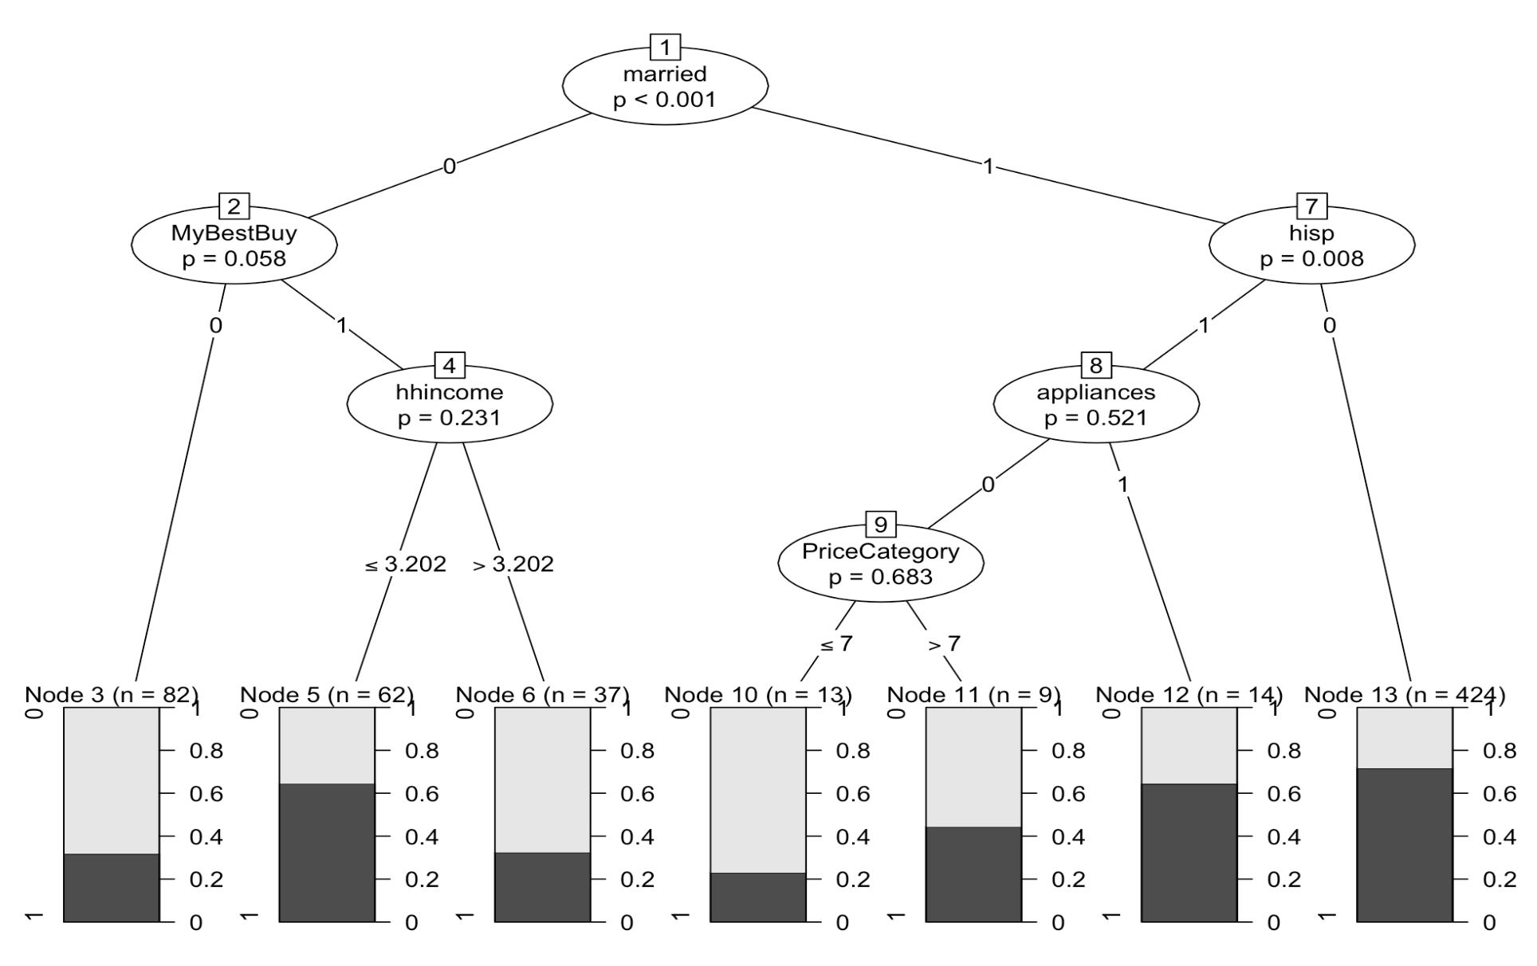
Result of Random Forest Model
Notes:
We use our test dataset to predict outcomes from our trained model. The test dataset is passed through each of these 500 decision trees and based on the majority voting, one output is predicted. The diagram below shows the decision tree which was voted by others. It shows the splits occur on p-values, but the p-values splits are only significant in 'married' and 'hispanic' (p < 0.005).

Slide 9
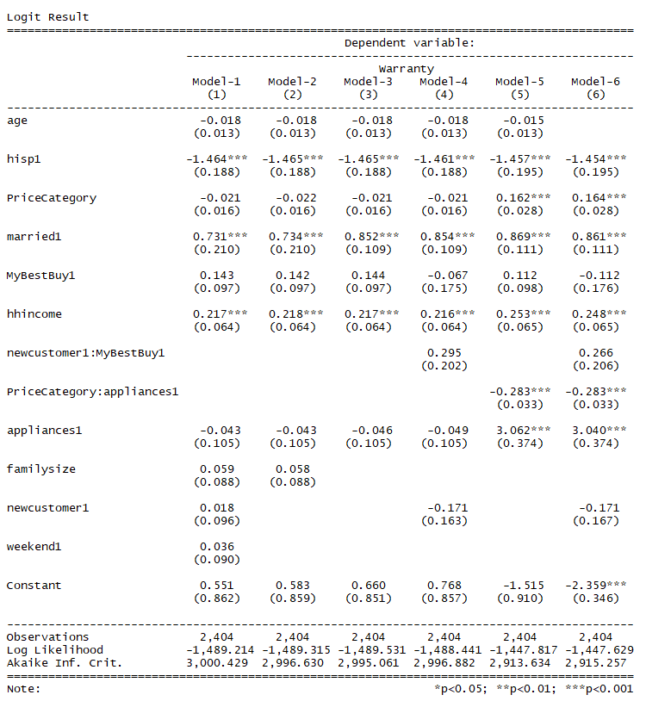
Result of Binary Logit Models
Significant features:
Hispanic
Married
Household income
Price Category X Home Appliance
AIC: 2913.634
Notes:
Before we build the model, we thought as price category going higher people would more likely to put extra insurance on their product. However, after we run the first model, we see the opposite result. Therefore, we make the interaction term of price category*Home Appliance.

Slide 10
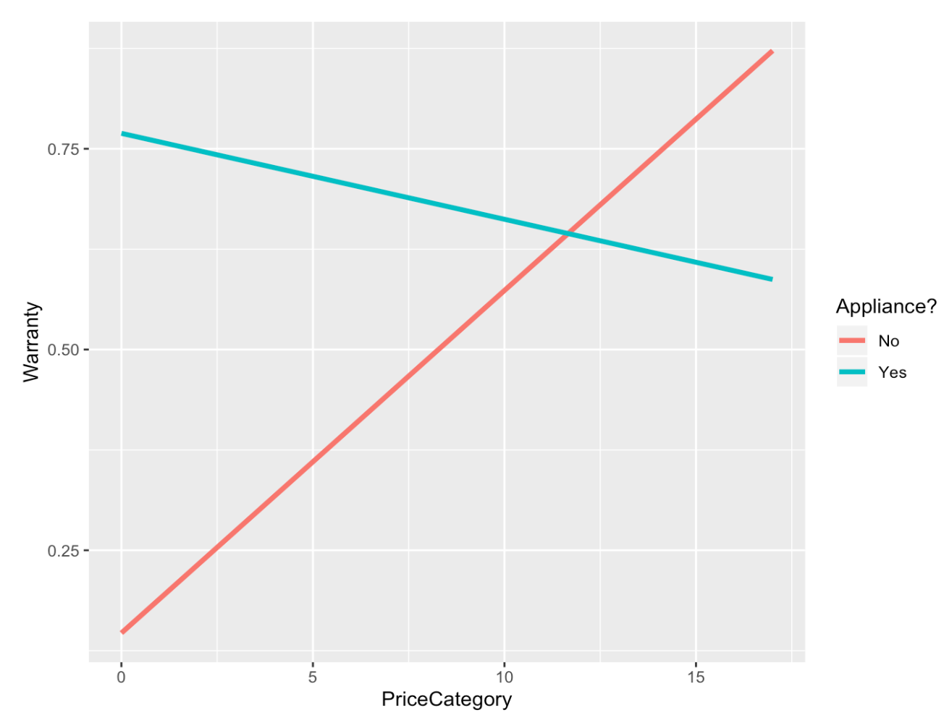
Model Visualization
Notes:
As the graph shown, the interaction term actually give more insights to us. For none home appliance, as the price going up, people are actually more likely to buy geek squad warranty as we expected. For home appliance, as the price going up, people are less likely to buy geek squad warranty. So we did some research on that, we find that a lot of home appliance, especially for those relatively more expensive home appliance, the product itself will come with warranty up to 10 years, which explains why people are less likely to put extra warranty on their home appliance.

Slide 11
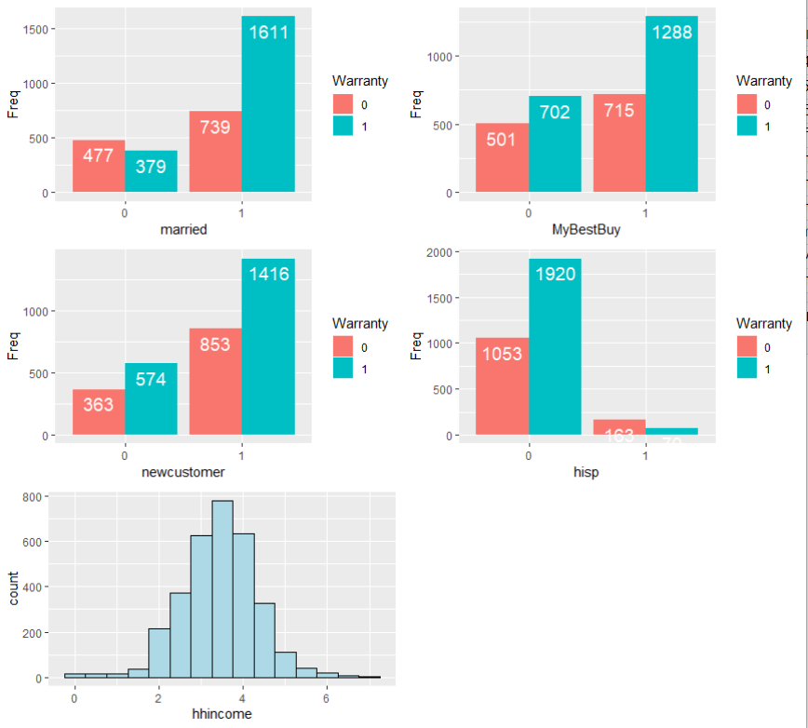
Model Visualization
Notes:
As we look into each variable, we find that for married people, their risk taking ability will be lower compared to not married people, which explains why more married people are likely to buy geek squad warranty. For MyBestBuy credit card holders, they can get certain amount of cash back if they use MyBestBuy credit card to buy geek squad warranty, therefore, more MyBestBuy credit card holders are willing to buy the geek squad warranty. For new customers, we think if the customers make their first purchase in BestBuy, they would more likely to put extra ‘insurance’ on their products, which explains the result shown in the graph. For Hispanic people, we actually read a paper talking about most of the Hispanic people are more likely to be risk takers, therefore, it explains the result in the graph. Also for people with medium household income, their risk taking ability are relatively lower, so more people with medium household income are willing to buy the geek squad plan.

Slide 12
Recommendation
Target Customers group:
Married
MyBestbuy Credit Card Owners
New customers
Customers who have medium household income
None Hispanic
Purchase home appliance with relatively low price
Purchase non-home appliance with relatively high price
Notes:
With all being said, we should target customers as shown in the page.

Slide 13
Limitation & Improvement
Limited data size
Age variable is skewed to the left (52 years to 86 years old)
Information on Gender is not available
Customer preference information is not available
Notes:
However, after we are done with our analysis, we realize there are some limitations and improvements for our analysis. First of all, the data size our dataset is really small, therefore, it limit our ability to do further analysis. For age variable, it is skewed to the left, it also limit us to get more insights when we analyze the data. The lack of gender information is definitely a pain to us. Furthermore, we would like to get more customer preference information in order to run the clustering analysis in order to improve our recommendations.

Slide 14
Question?

